Slide 1
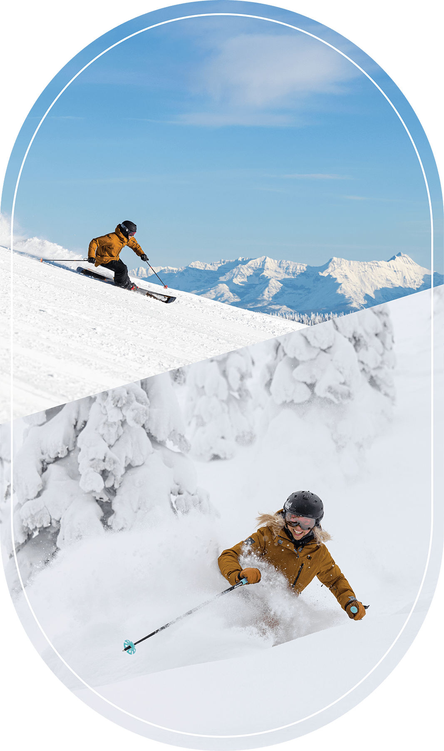
Big Mountain Resort Ticket Pricing Model

Slide 2
Problem Identification
Big Mountain Resort is not capitalizing on its facilities as much as it could.
The goal is a new strategy to increase the revenue by:
Developing a new ticket pricing strategy or
Implementing operational changes such as adjusting facilities like adding spa, lift chairs, or other amenities.

Slide 3
Recommendation and key findings
Ticket Price:
Increasing Adult Weekend ticket from $81 to $85 can increase the revenue by almost $7M for the season and cover the cost of the additional chair lift.
Profitable Operational Changes Scenarios :
Permanently closing down 5 least used runs
Increasing the vertical drop by 150
Require installing an additional chair lift operating cost of 1,540,000
Increase support for ticket price by $1.99 and an increase of $3,474,638 in revenue
Expected profit of around $2M

Slide 4
Modeling results and analysis
Random Forest is selected as the ticket pricing model
Eight features with the highest impact on the ticket price are identified.
Big mountain resort ranks high or is well above the average in each of these categories

Slide 5
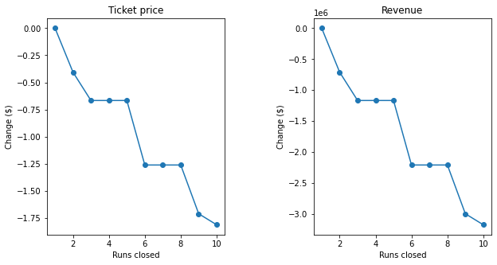
Modeling results and analysis
Scenario 1: Permanently closing down up to 10 of the least used runs.
The model shows closing one run makes no difference.
Closing 2 and 3 successively reduces support for ticket price and so revenue.
If Big Mountain closes down 3 runs, it seems they may as well close down 4 or 5 as there's no further loss in ticket price.
Increasing the closures down to 6 or more leads to a large drop.

Slide 6
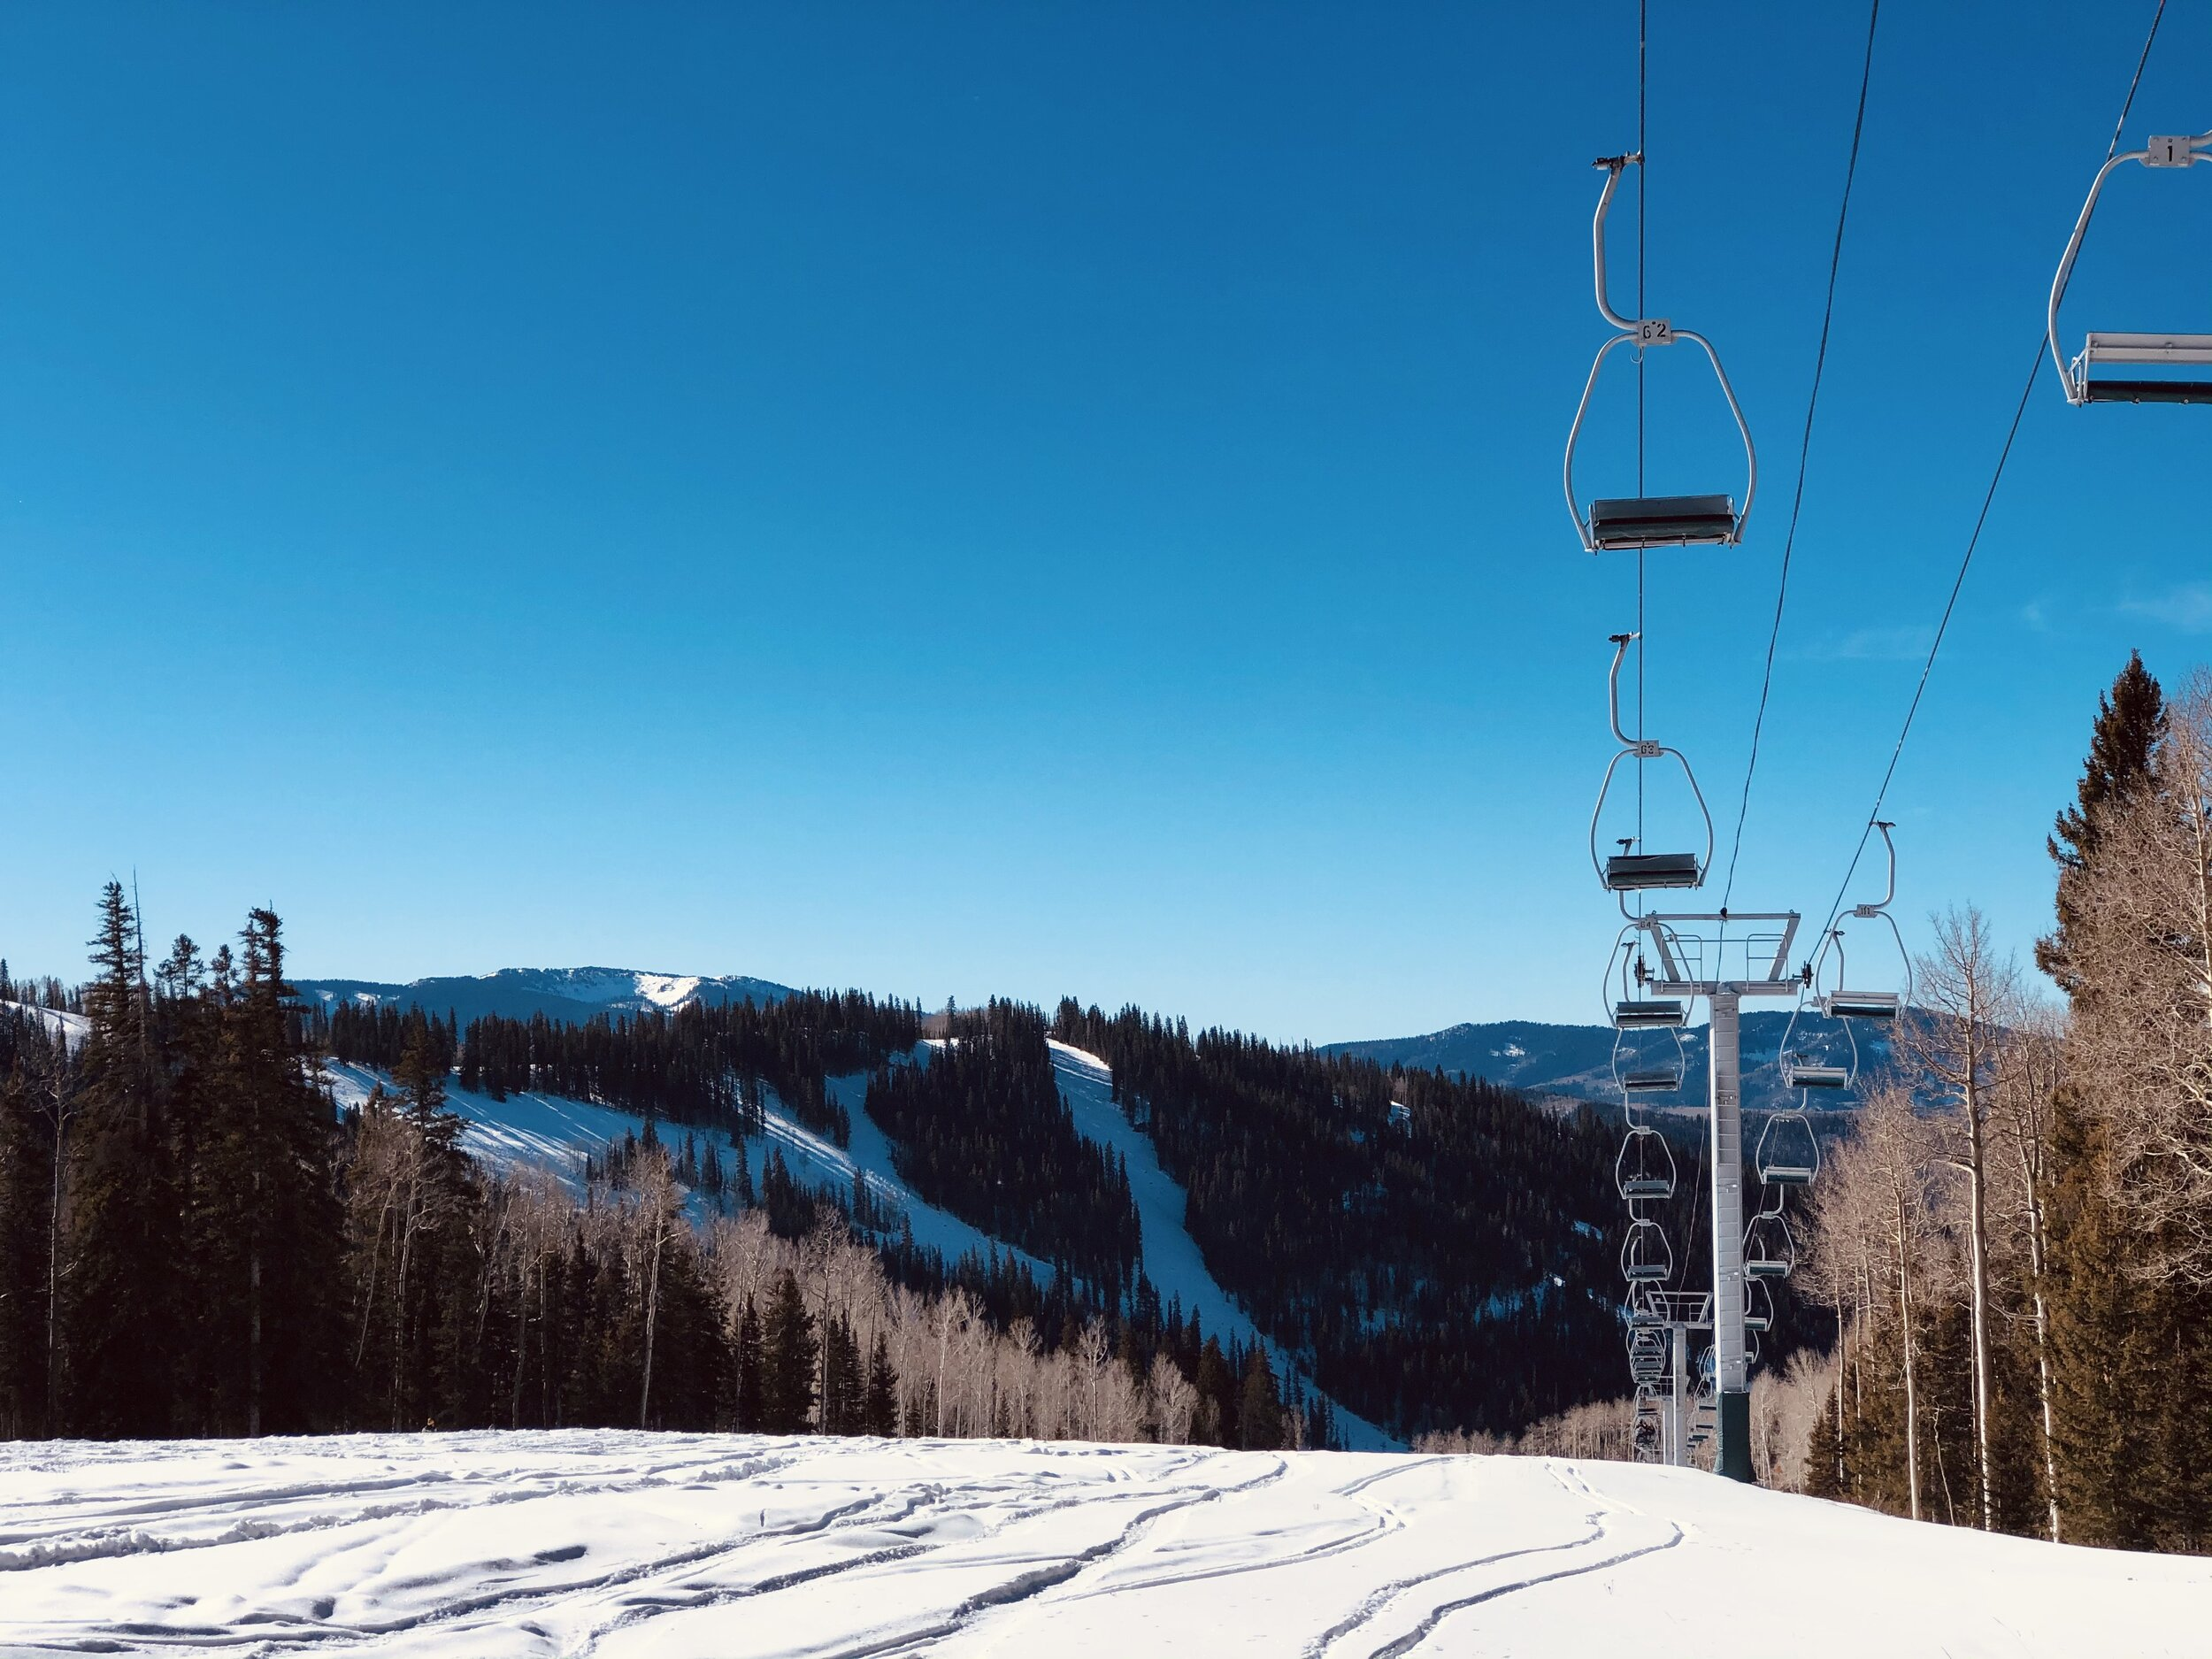
Modeling results and analysis
Scenario2: Increasing the vertical drop by 150 feet by adding a run, and installing an additional chair lift.
Increases support for ticket price by $1.99
Increase revenue by amount of $3,474,638.

Slide 7
Summary and conclusion
A Random Forest model is used to examine the new pricing strategy.
Increasing Adult Weekend ticket from $81 to $85 which can increase the revenue and cover the cost of the additional chair lift is recommended along with:
Closing least used run,
Adding an additional run, and chair lift to increase the vertical drop by 150ft.

